Slide 1
Group Project: PASSWORD GENERATOR
4th December 2018
Submitted by:
Group 16
Madhavee Kaushik
Tanvi Puri
Tanveer Khan

Slide 2
IDEA

Slide 3
Require passwords for Website logins, email accounts, social media accounts, banking accounts, smart phone pass codes, credit card pin numbers.
Using same passwords for multiple accounts.
Using commonly used words (names, birthdays, “123456”, “Password”).
WHY ????.........we need stronger passwords.
to prevent security breach.
unauthorized access.
compromised data

Slide 4
PASSWORD GENERATORS
Generate unique and highly secure passwords using a combination of letters, numbers and symbols.
Combinations are difficult to guess.
Enables user’s to personalize passwords.
Enable selection of different password generation techniques.

Slide 5
Generate passwords using constraints.
Selecting one of the following password generation techniques:
The random string method:
Generates random string of numbers, letters and special characters.
The PassPhrase method:
Create random set of words and string them together.
The Person-Action-Object method :
Based on mnemonic memorization technique, to create story that is converted to a password .

Slide 6
MENU
PASS PHRASE METHOD
PERSON-ACTION-OBJECT ORIENTED METHOD
RANDOM STRING METHOD
ENTER LENGTH OF PASSWORD
ENTER LENGTH OF PASSWORD
ENTER LENGTH OF PASSWORD
GENERATE SET OF RANDOM WORDS
ENTER PERSON, ACTION,OBJECT
Password

Slide 7
COMPONENTS

Slide 8
USER
GUI STRUCTURE
SELECT METHOD
Source Code/ Algorithm
ENTER LENGTH & OTHER CONSTRAINTS.
PASSWORD
GENERATED

Slide 9
EXPLANATION
A. Component 1: User
In our project, the user is provided with option to select the password generation techniques and set the constraint for the password via a graphical user interface. As in our working model user is able to set the length of the password as a constraint.
B. Component 2: GUI structure:
In our project we implemented the Graphical User Interface using Pyqt5. Pyqt5 is a module that can be used to create graphical user interfaces (GUI). Widgets are basic building blocks of an application. PyQt5 has a wide range of various widgets, including buttons, check boxes, sliders, or list boxes. Some widgets used here are Menu, radio button, text edit and progress bar among others. GUI structure will be explained in the document.

Slide 10
EXPLANATION
C. Source Code:
Select method: Code enables the user to select from the password generation techniques as they are displayed in the GUI in the menu.
Enter Length & Other constraints: Code enables to set the length of the password to be generated as the constraint in password generation.
D. Result -Password generated:
The code outputs a unique password created using one of the password generation techniques and by putting a length constraint by the user on the password.

Slide 11
CLASSES

Slide 12
NAME OF THE CLASSES
RandomString_Generator
PassPhrase_Generator
PersonActionMethod_PasswordGenerator
Menu

Slide 13
CLASS-RandomString_Generator
Random string generator class inherits attributes from the parent class QWidget. This class defines different methods to load words, choose word, generated, cleared, default, numbers, use info_window in order to generate a graphical user interface that creates a unique password with random numbers, letters and symbols and at same time letting user choose default length constraint or set the length.

Slide 14
CLASS-PassPhrase_Generator
Pass Phrase generator class inherits attributes from the parent class QWidget. This class defines one method to load words. Three random words are chosen using choose_word function from the wordlist_filename file and make a combination of the alphabets used in it according to the entered length.

Slide 15
CLASS-PersonActionMethod_PasswordGenerator
Person-Action-Method Password generator class inherits attributes from the parent class QWidget. This class defines one method to load words. Three words are taken as input from the user. A combination of alphabets according to the entered length is given out as password.

Slide 16
CLASS-Menu
This class is implemented to create the menu graphical user interface for displaying a window based on the selection of the one of the password generation technique. It uses the method layout to generate the window relative to the password generation technique.

Slide 17
IMPLEMENTATION OF GUI

Slide 18
Implemented the idea of password generator in a GUI using PyQt5.
PyQt5 : A module that can be used to create graphical user interfaces (GUI). Widgets are basic building blocks of an application. PyQt5 has a wide range of various widgets, including buttons, check boxes, sliders, or list boxes. Some widgets used here are Menu, radio button, text edit and progress bar among others.
MENU enables selection of one of the following password generation techniques.
Random String
Pass-Phrase
Person-Action-Object

Slide 19
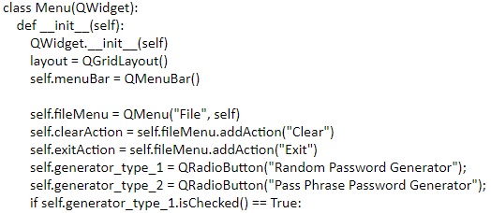
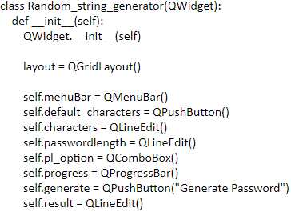
MENU GUI enabling selection of one of the password generation techniques.

Slide 20
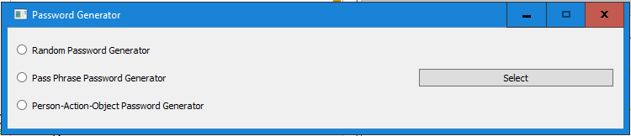
The below format allows to create the MENU.
void QGridLayout::addWidget(QWidget *widget, int fromRow, int fromColum, int rowSpan, intcolumnSpan, Qt::Alignment alignment = ...)
Our Implementation:
MENU CODE:
layout.addWidget(self.generator_type_1, 0, 0)
layout.addWidget(self.generate, 1, 2)
layout.addWidget(self.generator_type_2, 1, 0, 1, 2)
layout.setMenuBar(self.menuBar)

Slide 21
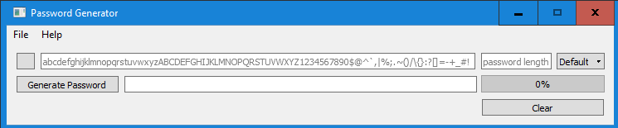
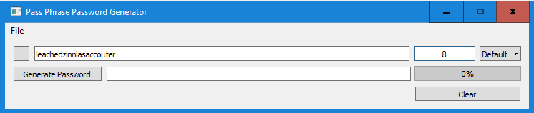
GUI provides password length as a constraint to the user.
GUI shows password strength.

Slide 22
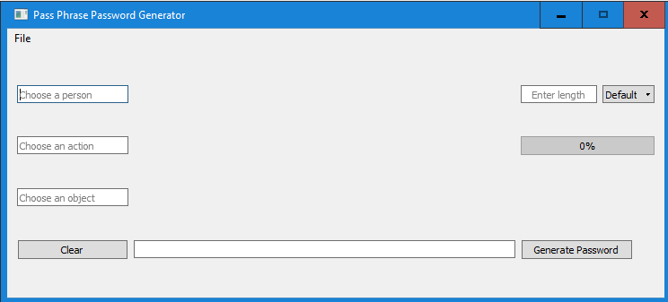
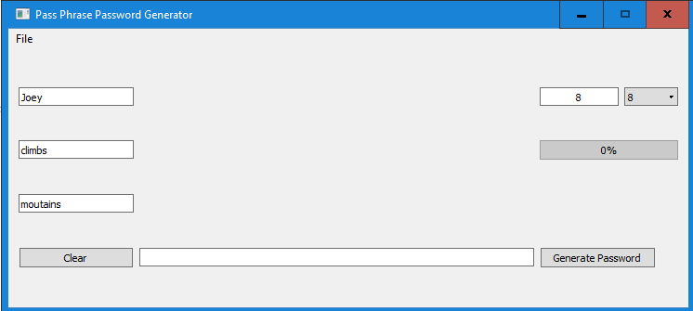

Slide 23
RESULTS

Slide 24
RESULTS: Method 1: Random String Method
Input is set as default string.
It is the combination of alphabets, numbers and special characters.
And enter the length of the password.
Input can be taken manually by user.

Slide 25
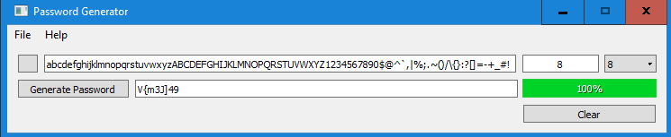
RESULTS: Method 1: Random String Method
Length Constraint
Test Case 1:
Password Strength

Slide 26
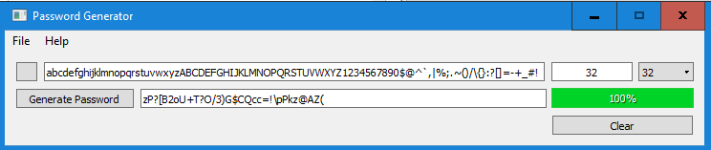
RESULTS: Method 1: Random String Method
Test Case 2:

Slide 27
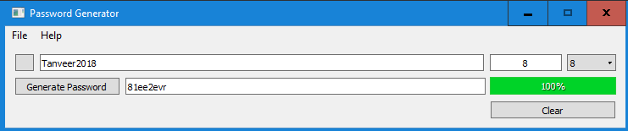
RESULTS: Method 1: Random String Method
Test Case 3:

Slide 28
RESULTS: Method 2: Pass Phrase Method
Input is the string made up by three words.
Words are randomly taken from the dictionary.
And enter the length of the password.

Slide 29
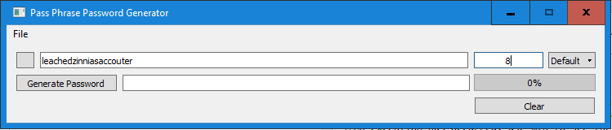
RESULTS: Method 2: Pass Phrase Method
Test Case 1:
LEACHED-ZINNIAS-ACCOUTER

Slide 30
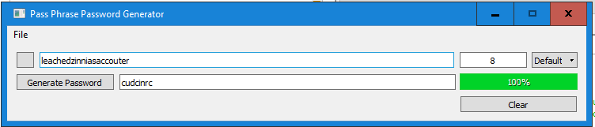
RESULTS: Method 2: Pass Phrase Method
Test Case 1:
LEACHED-ZINNIAS-ACCOUTER

Slide 31
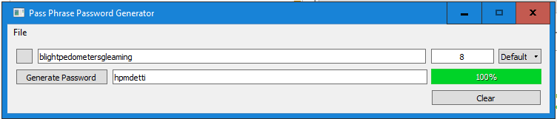
RESULTS: Method 2: Pass Phrase Method
Test Case 2:
BLIGHT-PEDOMETERS-GLEAMING

Slide 32
RESULTS: Method 3: Person-Action-Object Oriented Method
User has to enter name of a person.
An action for the person
An object related to the action.
And enter the length of the password.

Slide 33
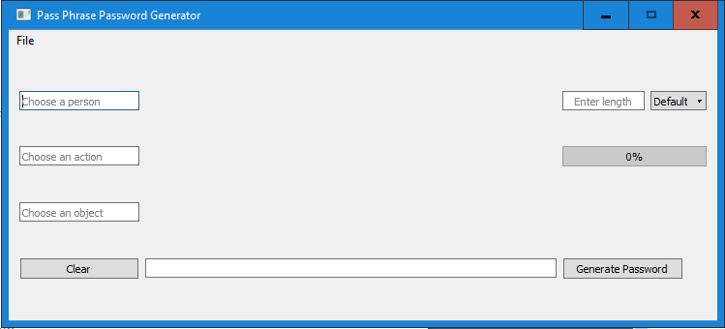
RESULTS: Method 3: Person-Action-Object Oriented Method
Test Case 1:

Slide 34
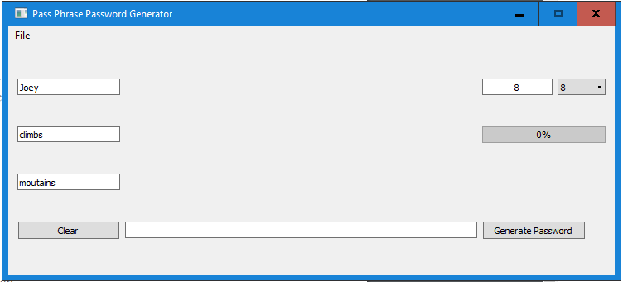
RESULTS: Method 3: Person-Action-Object Oriented Method
Test Case 1:

Slide 35
Remaining Work:
Three password generation techniques are implemented separately.
Two of them are fully functional and GUI of the third one is prepared.
Integration of all the methods together is left.

Slide 36
FUTURE IMPROVEMENTS
Substitution of alphabets with special characters.
Example:
“S” for $
“H” for #
“E” for 3
“I” for !
And more.

Slide 37
THANK YOU

